Slide 1
Datatypes and operators
Presented by :Narendra

Slide 2
Data types
Data Types describe what type of data can hold in our variables.
data in number type, character type, decimal number type,
group of characters....etc
Basically in Java we have 2 type of data types
1. primitive data Type
2. Collection data type ( Non-primitive data tyeps)

Slide 3
Primitive data types
--> which variable can hold single value such type of data types are
primitive data Type
Boolean datatype, character datatype , integral datatype
int rollNo=120,char ch=‘A’,

Slide 4
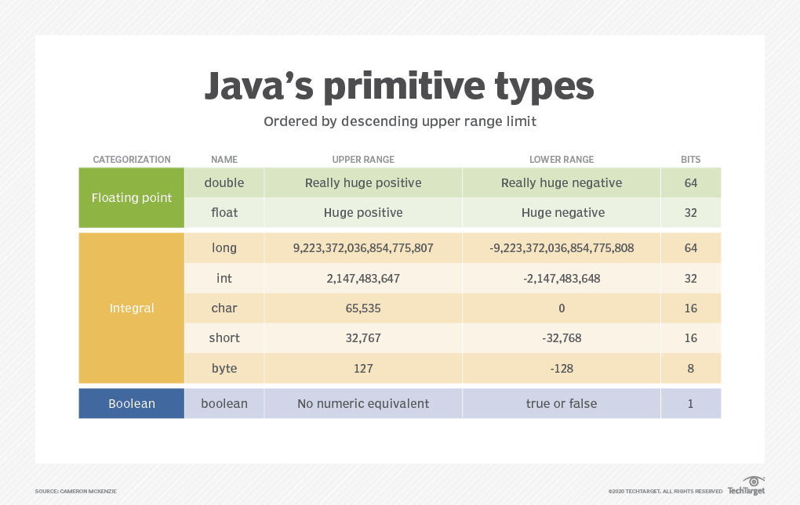

Slide 5
Non primitive datatypes
which object can hold more than one value . Then go with
collection type data types or Non-primitive data types.
Ex: arrays,list,set,map,String

Slide 6
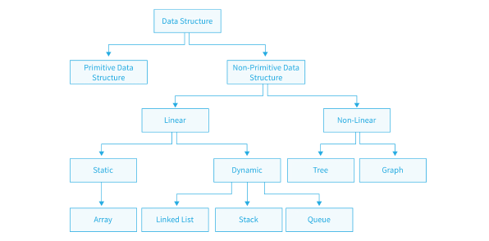

Slide 7
operators
In Java, operators are special symbols and keywords used to perform various operations on variables and values. They are classified into several categories, including
Arithmetic operators
Relation operators
Logical operators
Bitwise operators
Assignment operators
Increment/decrement operators
Conditional(ternary) operator

Slide 8
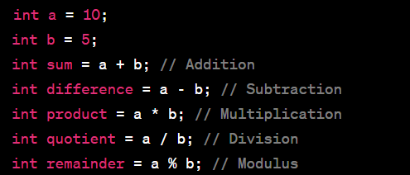
Arithmetic operators
There operators are used to perform arithmetic operations such as addition , subtraction ,multiplication , division ,modulus

Slide 9
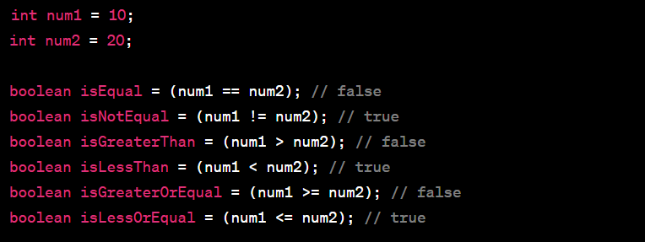
Relational operators
The use of relational operators are to campare two operands
and return either true value or false value.

Slide 10
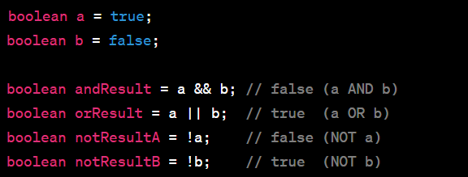
Logical operator
the use of logical operators are to compare more one condition then go with logical operators.
Logical operators work based on Logic Gates
AND,OR and NOT.

Slide 11
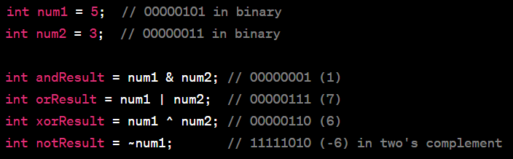
Bitwise operators
--> The use of bitwise operators are to perform operation
at binary level values.
Our Variable values internally convert into binary numbers
and perform operations Based On Logical GATE AND,OR,XOR and NOT .
finally Return result in integer values.

Slide 12
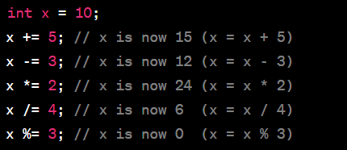
Assignment operators
To assign new value to the existing variable value.
then go with assignment operators.

Slide 13
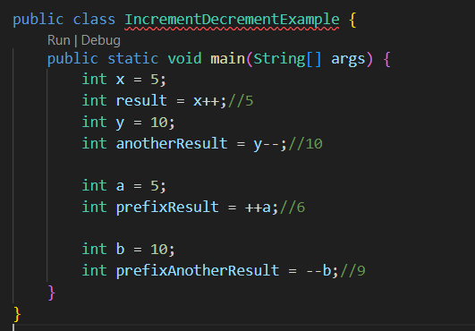
Increment/decrement operator
purpose is to increment/decrement only one value with existing variable value.

Slide 14

Conditional(ternary) operator
The conditional operator (?:) is used for a simple if-else statement

Slide 15
Thankyou

